Slide 1
19CS3113S
Analysis and Design of Algorithms
Session – 34

Slide 2
NP-HARD GRAPH PROBLEMS
The strategy to show that a problem L₂ is NP-hard is
  Pick a problem L₁ already known to be NP-hard.
  Show how to obtain an instance I¹ of L₂ from any instance I of L₁ such that from the solution of I¹
- We can determine (in polynomial deterministic time) the solution to
instance I of L₁.
  Conclude from (ii) that L₁ α L₂.
  Conclude from (i),(ii), and the transitivity of α that satisfiability α L₁
L₁ α L₂
∴ Satisfiability α L₂
∴ L₂ is NP-hard

Slide 3
Clique Decision Problem(CDP) :
Clique: Clique is a maximal complete sub graph of a graph G = (V,E)
– Size of a clique is the number of vertices in it

Slide 4
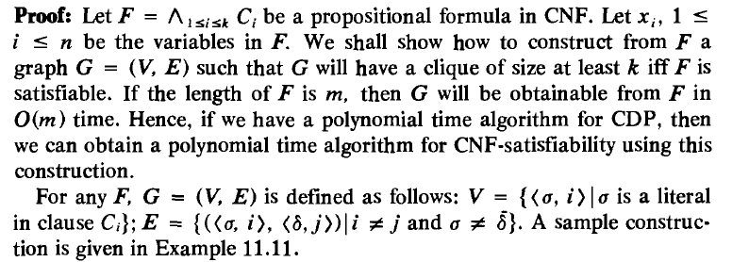
Theorem: CNF- satisfiability α Clique Decision Problem

Slide 5
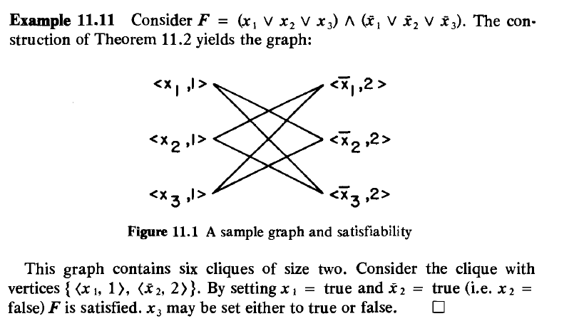

Slide 6
Thank you

